Slide 1
Opinon Mining
On Twitter
By Python

Slide 2



Popularity of Social Media
The popularity of Social media Such As Facebook and Twitter turned them into main channels to communication and share Opinions on Politic , Economic, Social , and Cultural issues

Slide 3

Peoples on Social Media

Slide 4

Definition of Opinion Mining
Opinion mining is the area of research that attempts to make automatic System to determine human opinion from Text written in natural language

Slide 5

Peoples wants to know opinions of Other

Slide 6

Opinion Mining as Discipline
In these days Opinion Mining attract increased attention within fields such as Marketing, Recommendation System and Financial market prediction

Slide 7
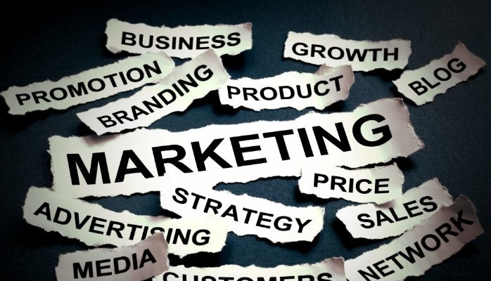
Opinion Mining is Used in Every Fields

Slide 8

Opinion Mining in Marketing Opinion mining is Primarily used today by companies to Determine Costumer Preference determine price, Impact on Sale, etc.

Slide 9

Consider the Following Scenario A major Computer Manufacture, disappointed with unexpected low sales, Find itself confronted with this question
Why aren’t consumers buy our laptop?

Slide 10

After Opinion Mining
They find reason behind their low sale is ” his rival Companies providing faster Processor and bigger Screen in low price”, So Consumers are attracted to their Products

Slide 11
Modification After Opinion Mining The Company also ready to providing faster processor and bigger Better Screen in low price

Slide 12

Opinion Mining on Recommendation System Peoples are bit confused among products so he go for recommendations from others

Slide 13
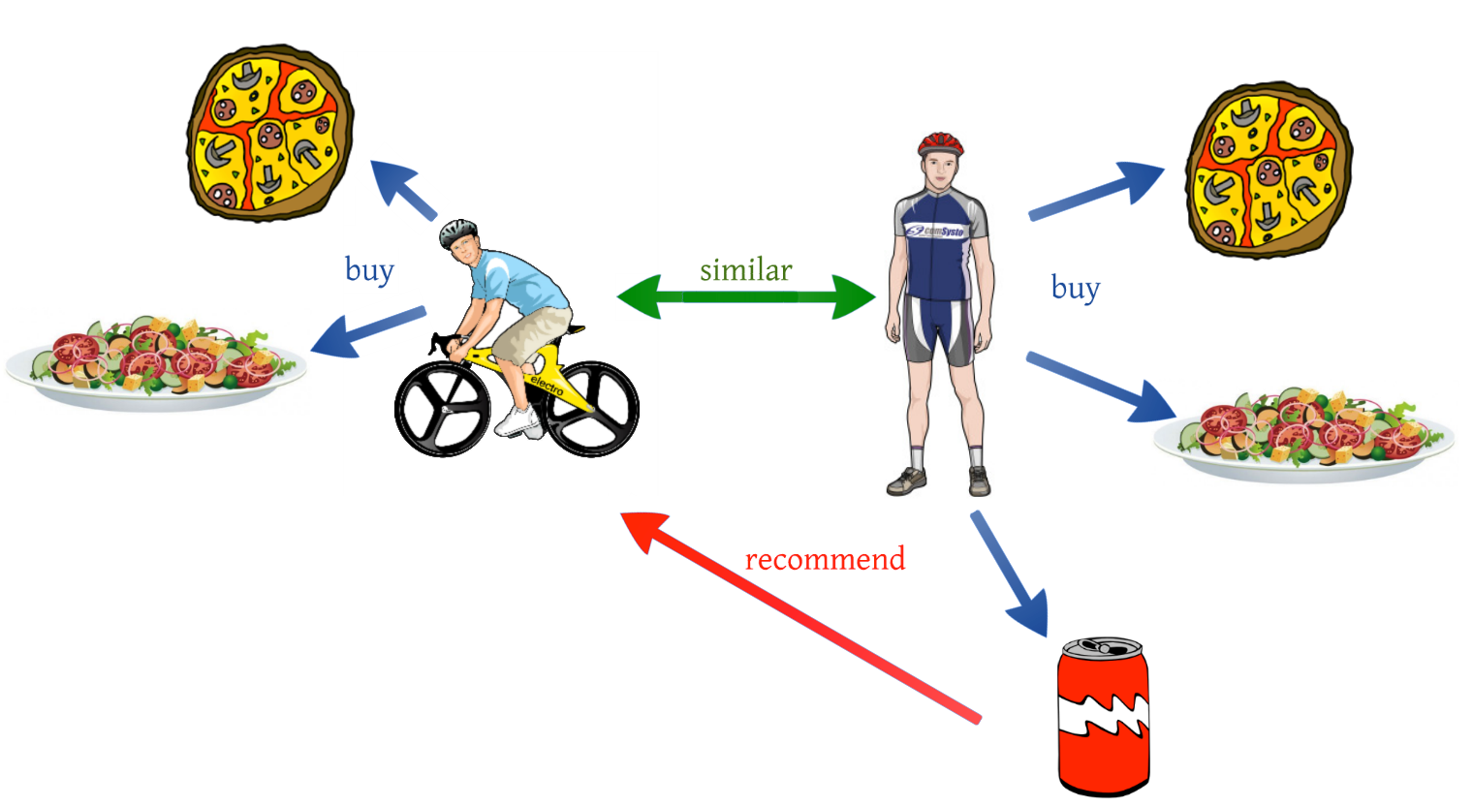
How Recommendation System Work

Slide 14
Effect of Opinion Mining on Recommendation System
In Current Days various online shopping companies recommend their product to customers based on customers’ personal information and online behavior. They observe the large amount of review data with exponential growth. Based on observation, They recommend products based on opinion mining.

Slide 15
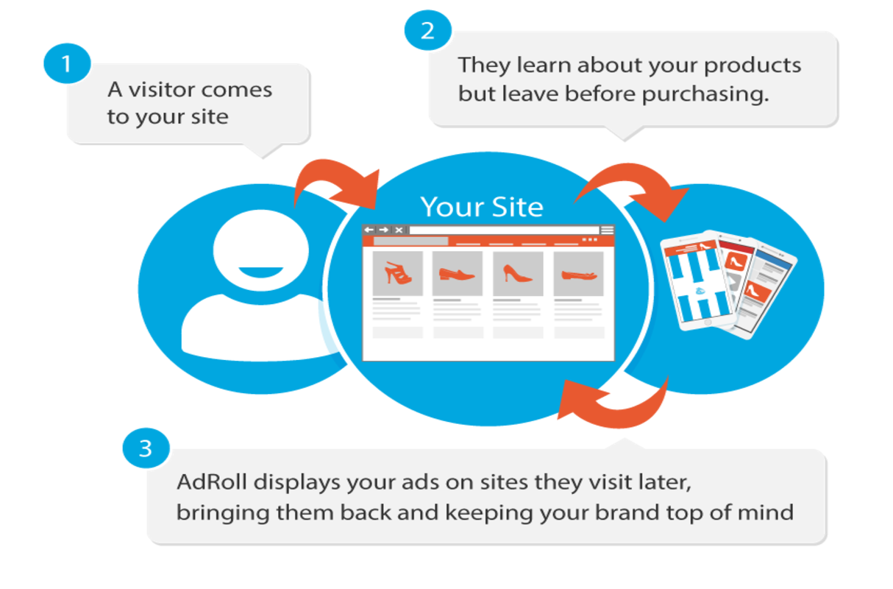

Slide 16




Consider A Case Where a person is confused among movies, Which movie he should watch now

Slide 17



In this situation he go for movie review

Slide 18


Financial Stock market forecasting using Data mining
Data mining is well founded on the theory that the historic data holds the essential memory for predicting the future direction. This technology is designed to help investors discover hidden patterns from the historic data that have probable predictive capability in their investment decisions.

Slide 19
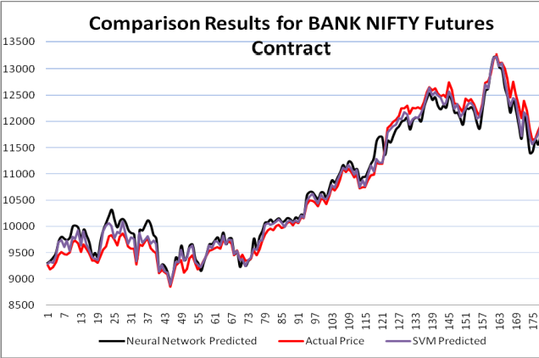

Slide 20
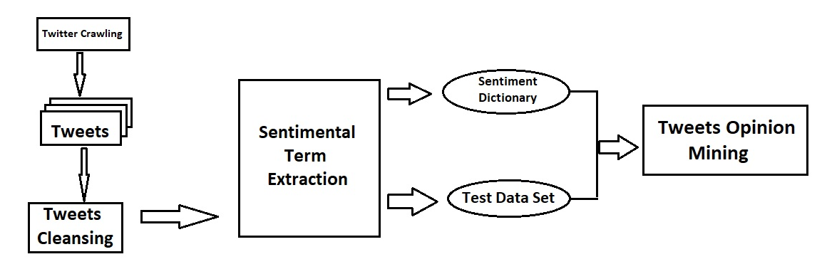
Applied Procedure in my Project

Slide 21

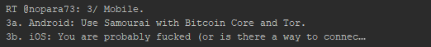
Consider Following Tweets
Due to the word “Lovely” this Tweet is considered as Positive Tweet
Because in this Tweet there is nether a Positive term or nor Negative term so this tweet is Considered as Natural Tweet
Due to the word “fucked” this tweets is Considered as Negative Tweet

Slide 22
A Case Study of Twitter Opinion on Nuclear Power
Nuclear power is a significant national issue because it is a double edged sword . Economic efficiency of power generation is the most important benefit of Nuclear power . However, the potential risk of radiation leakage is the biggest difficulty of nuclear power

Slide 23
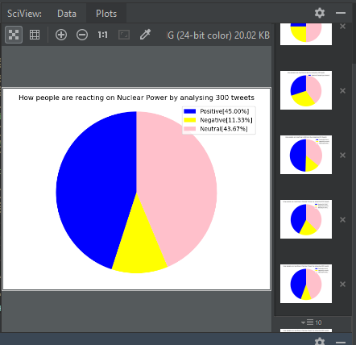
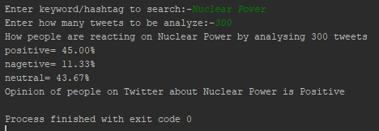
Pie Chart of Opinion Mining on Nuclear Power

Slide 24
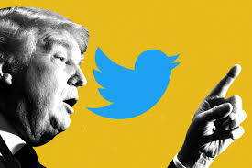
Case Study of Twitter Opinion on Donald Trump

Slide 25
As is well known, Opinion matter a great deal in Politics . Some Work has focused on understanding what voter are thinking

Slide 26
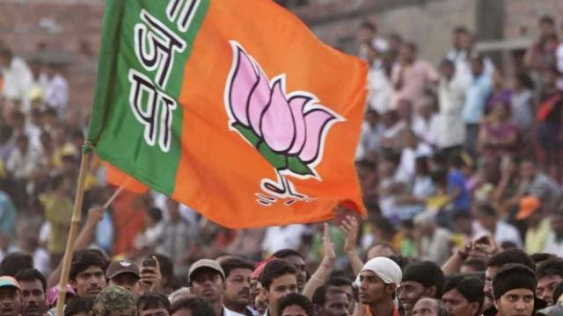
Case Study of Twitter Opinion on Bharatiya Janata Party

Slide 27
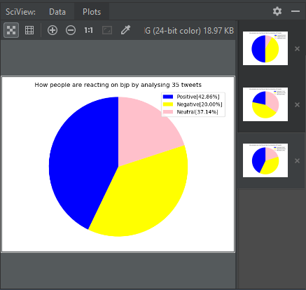
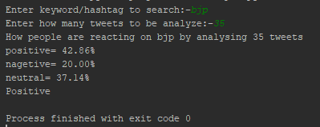
Opinion of people on Twitter of BJP

Slide 28

Case Study of Twitter Opinion on Bitcoin
1 Bitcoin = 4,84,569.34 Indian Rupee

Slide 29
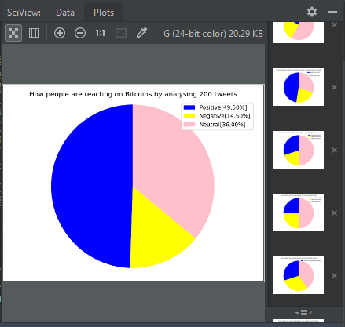
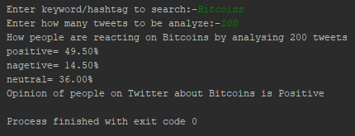
Opinion of People on Twitter about Bit coin

Slide 30



